Slide 1
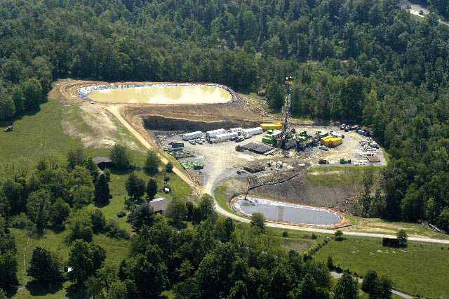

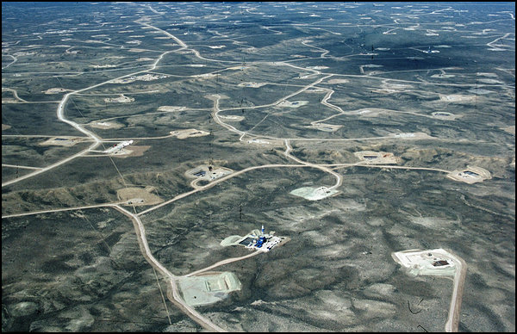
Study of the Potential Impacts of Hydraulic Fracturing on Drinking Water Resources
PROGRESS REPORT
U.S. Environmental Protection Agency
Office of Research and Development
January 3-4, 2013

Slide 2
Webinar Outline
Study background
Progress report
Stakeholder engagement
  Technical Roundtables update
  Next steps
Questions?

Slide 3
Study Background
In its 2010 Appropriations Committee Conference Report, Congress urged EPA to study the relationship between hydraulic fracturing and drinking water, using:
Best available science
Independent sources of information
Transparent, peer-reviewed process
Consultation with others

Slide 4
Study Timeline
US Congress urges the EPA to conduct a study
Peer review of
draft report of results
Peer review of draft study plan*
(February – August 2011)
Release progress report*
Final report
of results
Release final study plan (November 2011)
Planning
Conduct Research
Report of Results
Technical workshops
(February – March 2011)
Technical roundtables*
(Summer 2013)
Meetings with stakeholders to identify concerns and study scope
(July – August 2010)
Technical workshops*
(Spring 2013)
Technical roundtables* / information request
(November 2012)
*Webinars conducted to provide updates
Notes:
Release and peer review of draft report of results (Dec. 2014)

Slide 5
Purpose of the Study
Assess whether hydraulic fracturing may impact drinking water resources
Identify driving factors that may affect the severity and frequency of impacts
Purpose of the Progress Report
Demonstrate progress made on the EPA’s Study of the Potential Impacts of Hydraulic Fracturing on Drinking Water Resources
  Project-specific updates that include research approach, status and next steps
Notes:
No research results are included in this Progress Report

Slide 6
Progress Report
Chapter 1: Introduction
Chapter 2: Overview of the Research Study
Chapter 3: Analysis of Existing Data
Chapter 4: Scenario Evaluations
Chapter 5: Laboratory Studies
Chapter 6: Toxicity Assessment
Chapter 7: Case Studies
Chapter 8: Conducting High Quality Science
Chapter 9: Research Progress Summary and Next Steps
Appendix A: Chemicals Identified in Hydraulic Fracturing Fluids and Wastewater
Appendix B: Stakeholder Engagement
Appendix C: Summary of Quality Assurance Project Plans
Progress report is available at www.epa.gov/hfstudy

Slide 7
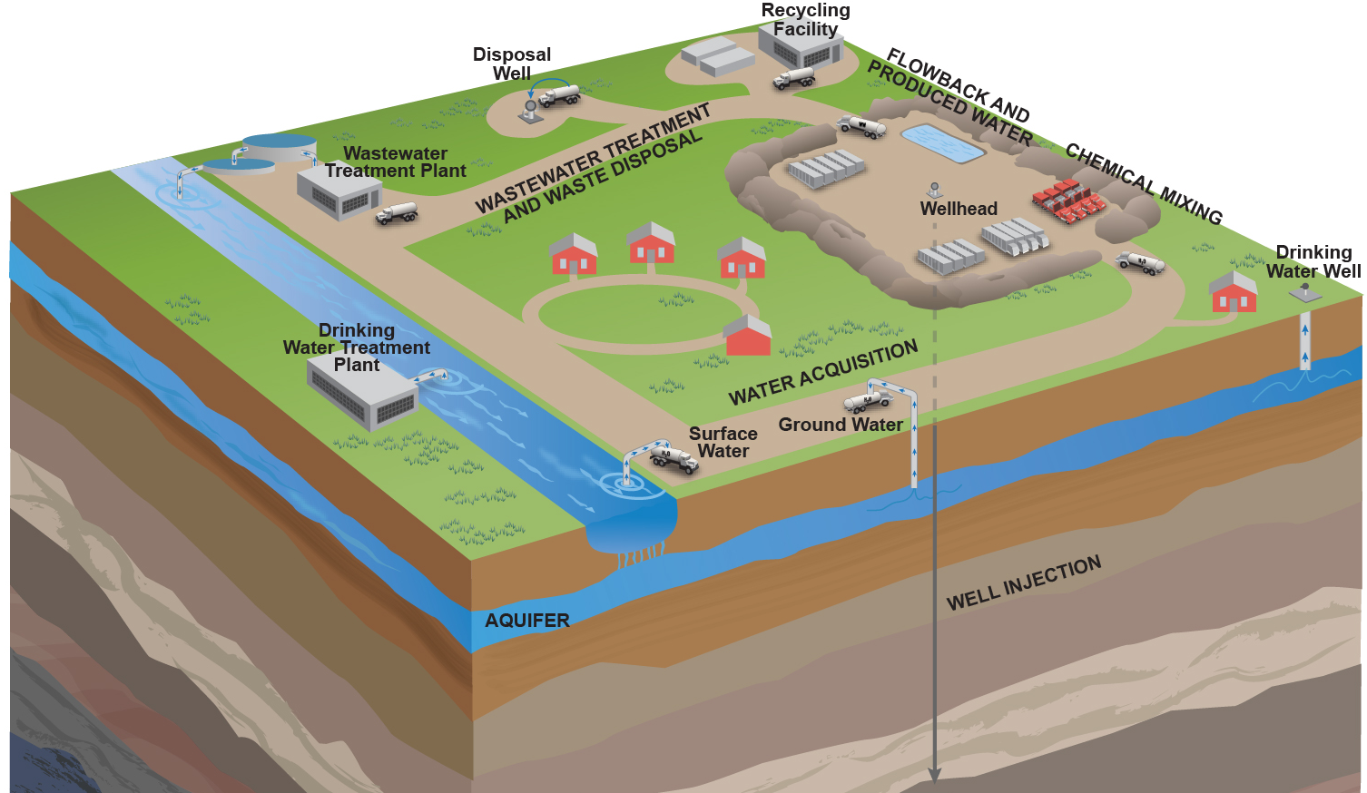
Chapter 2
Research Overview
WATER CYCLE STAGES
Water Acquisition → Chemical Mixing → Well Injection →
Flowback and Produced Water → Wastewater Treatment and Waste Disposal
Notes:
Chapter 9 includes a synthesis of progress made by water cycle stage

Slide 8
Chapter 2
Research Overview
Water Use in Hydraulic
Fracturing Operations
What are the potential impacts on drinking water resources of:
Water Acquisition
Large volume water withdrawals
from ground and surface waters?
Chemical Mixing
Surface spills on or near well pads
of hydraulic fracturing fluids?
Well Injection
The injection and fracturing process?
Flowback and
Produced Water
Surface spills on or near well pads
of flowback and produced water?
Wastewater Treatment and Waste Disposal
Inadequate treatment of
hydraulic fracturing wastewaters?

Slide 9
Chapter 2
Research Overview
Stages
Primary Research Questions
Secondary Research Questions
Research Projects
Research Approach
Secondary Research
Question 1
Research Project 1
Research
Activity 1
Research Project 2
Water Cycle Stage
Primary Research Question
Secondary Research
Question 2
Research Project 3
Secondary Research
Question 3
Research
Activity 2
Research Project 4
WATER CYCLE STAGES
Water Acquisition → Chemical Mixing → Well Injection →
Flowback and Produced Water → Wastewater Treatment and Waste Disposal
Notes:
Chapter 9 includes a synthesis of progress made by water cycle stage

Slide 10
Chapter 3
Analysis of Existing Data
Research Project | Description
Literature Review | Review and assessment of existing papers and reports, focusing on peer-reviewed literature
FracFocus Analysis | Analysis of data compiled from FracFocus, the national hydraulic fracturing chemical registry operated by the Ground Water Protection Council and the Interstate Oil and Gas Compact Commission
Spills Database Analysis | Analysis of selected federal and state databases for information on spills of hydraulic fracturing fluid and wastewater
Service Company Analysis | Analysis of information provided by nine hydraulic fracturing service companies in response to a September 2010 information request on hydraulic fracturing operations
Well File Review | Analysis of information provided by nine oil and gas operators in response to an August 2011 information request for 350 well files
RESEARCH PROGRESS
Data sources have been identified for review and analysis, including:
  Over 12,000 well records entered into FracFocus
  State spill databases from Colorado, New Mexico and Pennsylvania
  National Response Center spill database
  Information provided by 9 hydraulic fracturing service companies
  333 well files supplied by 9 oil and gas operators
Literature review is ongoing

Slide 11
Chapter 4
Scenario Evaluations
Research Project | Description
Water Availability Modeling | Assessment and modeling of current and future water use scenarios in the Upper Colorado River Basin and the Susquehanna River Basin
Subsurface Migration Modeling | Numerical modeling of subsurface fluid migration scenarios that explore the potential for gases and fluids to move from the fractured zone to drinking water aquifers
Surface Water Modeling | Modeling of concentrations of selected chemicals at public water supplies downstream from wastewater treatment facilities discharging treated hydraulic fracturing wastewater
RESEARCH PROGRESS
Computer models have been identified, including TOUGH+, HSPF, SWAT
Scenarios have been constructed:
  Future water use scenarios, including business-as-usual, full development and “green” technologies
  Fluid and gas migration due to faulty well construction, nearby wells, existing faults and fractures
  General surface water discharge scenarios based on data from wastewater treatment facilities in Pennsylvania
Models are being run
Sensitivity analyses will be conducted

Slide 12
Chapter 5
Laboratory Studies
Research Project | Description
Analytical Method Development | Development of analytical methods for selected chemicals found in hydraulic fracturing fluids or wastewater
Source Apportionment Studies | Development of a method to identify the potential source(s) of surface water contamination
Wastewater Treatability Studies | Assessment of the efficacy of common wastewater treatment processes on removing selected chemicals found in hydraulic fracturing wastewater
Br-DBP Precursor Studies | Assessment of the ability of chemicals found in hydraulic fracturing wastewater to form brominated disinfection byproducts (Br-DBPs) during drinking water treatment processes
RESEARCH PROGRESS
Analytical methods are being adapted and tested for several classes of chemicals, including:
  Glycols, acrylamide, ethoxylated alcohols, radionuclides, inorganic chemicals
Samples of surface water, raw hydraulic fracturing wastewater and treated effluent have been collected and are undergoing laboratory analyses
Wastewater treatability experiments are being designed
Studies assessing the ability of hydraulic fracturing wastewater to create Br-DBPs are underway

Slide 13
Chapter 6
Toxicity Assessment
For hydraulic fracturing fluids and wastewater:
Identify chemicals in injected fluid and wastewater
  Sources include: service company data, well files, FracFocus, state and federal reports
  Identify chemical name, CASRN, chemical structure
Compile information on chemical, physical and toxicological properties
  Chemical and physical properties from LeadScope, EPISuite, QikProp
  Toxicological properties from federal and state databases
  (e.g., IRIS, State of California Toxicity Criteria Database)
Estimate properties for chemicals with known structures, but unknown properties, using quantitative structure activity relationships
RESEARCH PROGRESS
Over 1,000 unique chemical substances identified
  Chemicals are included in Appendix A of the progress report
Chemical structures are available for roughly 750 chemicals
  Some properties have been obtained for over 300 chemical structures

Slide 14
Chapter 7
Case Studies
Retrospective Case Studies | Investigation of potential drinking water impacts from…
Las Animas and Huerfano Counties, Colorado | Coalbed methane extraction in the Raton Basin
Dunn County, North Dakota | A well blowout during hydraulic fracturing for oil in the Bakken Shale
Bradford County, Pennsylvania | Shale gas development in the Marcellus Shale
Washington County, Pennsylvania | Shale gas development in the Marcellus Shale
Wise County, Texas | Shale gas development in the Barnett Shale
RESEARCH PROGRESS
Two rounds of samples have been collected and analyzed
Additional sampling is ongoing
The EPA continues to work with industry partners to design and initiate prospective case studies
Notes:
Data sources include:
Peer-reviewed literature
State and federal agencies
Industry responses to information requests
(HF service company data – Sept. 2010 request; Oil and Gas operators – August 2011 request)
Databases
Lit
Focus on water volume and source
Database
Received from industry in different formats, needs to be consistent. CBI issues. Compare to FracFocus. Queries being developed.
Difficult to extract HF specific info from spill databases. National Response Center. CO, NM, PA. TX and WY dropped.
Consistency issue with chemicals and fluids in FracFocus. 2D. Tox.

Slide 15
Chapter 8
Conducting High Quality Science
QUALITY ASSURANCE
Quality Management Plan defines the QA-related policies, procedures, roles and responsibilities for the study
Quality Assurance Project Plans document the planning, implementation and assessment procedures for individual research projects
  Available at www.epa.gov/hfstudy
PEER REVIEW
Products for individual research projects will undergo external peer review through scientific journals, letter reviews or ad hoc panels
Report of results has been classified as a Highly Influential Scientific Assessment
  Peer review will be conducted by the EPA’s Science Advisory Board

Slide 16
Chapter 9
Research Progress Summary and Next Steps
Progress Report
Science Advisory Board
Individual Reports and Papers
Draft Report of Results
Science Advisory Board Peer Review
Final Report of Results
2012
2013 – 2014
2014
Roundtables, Workshops and Webinars
Report of results will include a synthesis of available results from the research projects described in the progress report

Slide 17
Technical Stakeholder Engagement for EPA’s Study of the Potential Impacts of Hydraulic Fracturing on Drinking Water Resources
Technical Roundtables
Technical Workshops
Discuss specific technical topics identified by Roundtables.
SAB Meeting
Public face-to-face meeting of the SAB ad hoc Hydraulic Fracturing Advisory Panel. EPA will brief the SAB regarding the 2012 progress report.
March 2013
Technical Roundtables
November 14
Water Acquisition
Reconvene in Summer 2013 to provide continuity of stakeholder input.
Present and discuss EPA’s scientific research approach and progress.
Chemical Mixing
November 15
Report of Results
FEDERAL REEGISTER NOTICE to Request Data from the Public to Inform Ongoing Research
November 9, 2012
Release of 2012 Progress Report
Webinar
Well Injection
February 25, 2013
Analytical Chemical Methods Workshop
April 2013 (est.)
Well Construction / Operation and Subsurface Modeling Wastewater Treatment and Modeling
June 2013 (est.)
Water Acquisition Case Studies
Flowback & Produced Water
November 16
Wastewater Treatment & Waste Disposal
Peer Review Ongoing

Slide 18
Technical Roundtables
PURPOSE
EPA presented more detailed information on research underway
  One roundtable for each stage of the hydraulic fracturing water cycle
Allow participants to nominate topics for technical workshops
Seek a broad and balanced range of data and expertise from stakeholders
  Participants from the oil and gas industry, water industry, non-governmental organizations, local and state agencies, tribes and the academic community
Number of Participants: November 14-16, 2012
Stakeholder Group | Participants | Observers
Oil and gas industry | 23 | 2
Water industry | 8 | 1
Non-governmental organizations | 9 | 5
State/local governments | 16 | 3
Tribes | 1 | 1
Total | 57 | 12

Slide 19
Technical Roundtables
Water Acquisition: water availability and use; modeling; sources of water for hydraulic fracturing operations; potential impacts on water systems; recycling flowback waters
Chemical Mixing: analytical methods; trends in use of chemicals; indicator compounds; lifecycle assessment
Well Injection: well construction/operation; modeling assumptions, parameters and uncertainty
Flowback and Produced Water: spills database analysis; retrospective case studies; information on state databases available in Texas, Wyoming and Alabama; monitoring strategies for indicator compounds
Wastewater Treatment and Waste Disposal: wastewater treatability studies; residuals; validation of optimized methods for DBP studies; regional differences in wastewater practices; radioactive constituents; reused and reinjected wastewater
Materials from the Technical Roundtables are available at
http://epa.gov/hfstudy/techwork13.html

Slide 20
Technical Workshops
Technical Workshop Topics and Dates
Topic | Date
Analytical Chemical Methods | February 25, 2013
Well Construction/Operation and Subsurface Modeling | April 2013 (est.)
Wastewater Treatment and Modeling | April 2013 (est.)
Water Acquisition Modeling | June 2013 (est.)
Case Studies | June 2013 (est.)
IDENTIFYING TECHNICAL WORKSHOPS PARTICIPANTS
Nomination for Technical Workshop on Analytical Chemical Methods closes on January 8, 2013
Subject matter experts: submit resume and short abstract to participate
Registration for remaining workshops will open in January
See www.epa.gov/hfstudy for application information
Notes:
Technical Workshop on Analytical Chemical Methods: Workshop Themes
- Analytical methods for complex hydraulic fracturing matrices
- Determination of ‘chemicals of concern’
- Future trends in hydraulic fracturing chemicals usage
Use of tracers and indicators

Slide 21
Other Stakeholder Activities
WEBINARS
After technical workshops and roundtables in Summer 2013
INFORMATION REQUEST
Federal Register Notice requesting relevant studies and data, particularly peer-reviewed studies (November 9, 2012)
  Available at https://federalregister.gov/a/2012-27452
  To submit information:
    Follow the instructions at http://www.regulations.gov and identify your submission with Docket ID No. EPA-HQ-ORD-2010-0674
    Or email ord.docket@epa.gov, Attention Docket ID No. EPA-HQ-ORD-2010-0674
WEBSITE
Study updates are available at www.epa.gov/hfstudy
Sign up for email updates

Slide 22
Questions?
See the website for more information:
www.epa.gov/hfstudy

